Slide 1
Botnet Detection with HCP
Presented By:
Greg Phillips
Carolyn Duby
Amol Thacker
Ramasamy Baskaran
Vikas Sawhney
September 2018

Slide 2
Agenda
What is a botnet?
Why is botnet detection valuable?
How can we detect it with HCP?

Slide 3
What is a botnet?
Hosts infected with malware
Report to command and control (C&C)
C&C instructs them to do harm
Distributed Denial of Service (DDOS)
Spam
Social Media
Exfiltration
Unsecured IOT devices present new challenges

Slide 4
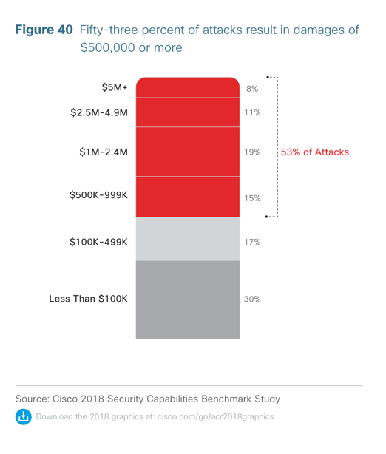
Why is botnet detection valuable?
Significant attack vector for organizations
IOT use is expanding
IOT security is weak
difficult or impossible to patch
lack of agents or security software
Easier to take over than a PC
Always on and can be called to action anytime
53% of attacks cost $500K or more

Slide 5
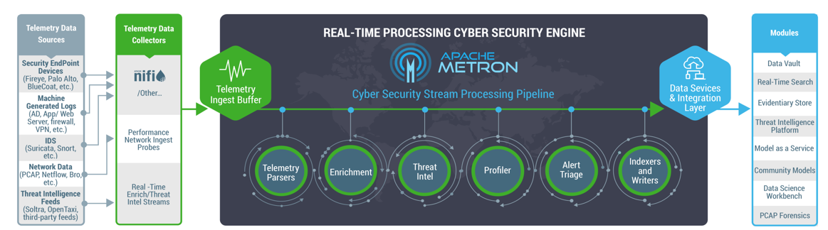
Detecting Botnets with Metron
Ingest DNS and NetFlow data
Apply botnet threat intelligence
Profilers detect anomalous traffic
Machine learning algorithms
Ensemble algorithms
Tracking: Source, Destination, Duration, Size, Protocol & Port
Domain / IP Blacklists for known attackers
Failed DNS queries
Anomalous levels of IRC traffic
DNS activity at predictable intervals
NLP analysis to find suspicious and/or generated domains
Combining several models for improved predictions

Slide 6


Slide 7

HCP Security Data Lake Architecture
Response, Visualization, Forensics, Hunting
Event Collection
Real time Normalization, Enrichment and Triaging
Metron UI
Nifi
Zeppelin
Bro
Storm
Analytics / Machine Learning
Netflow
Spark
Kafka
HBase
ZooKeeper Ranger Yarn
Enrichments
Event History
Solr
Threat Intel
Automated Responses
Hive
User
Orchestration
HDFS
Assets
Geo/Who is

Slide 8
Peek at the Solution

Slide 9
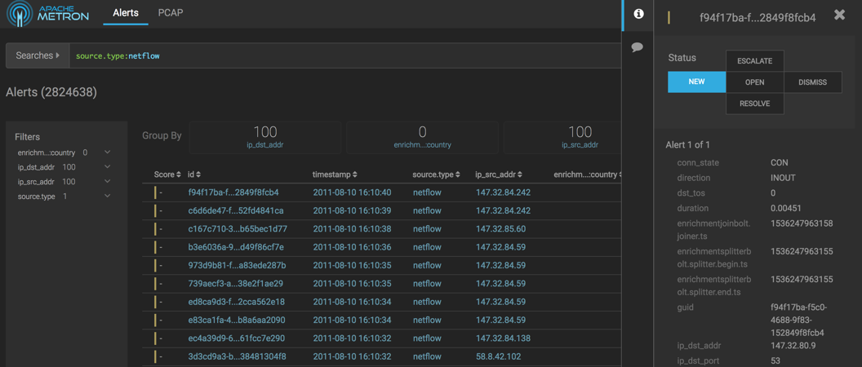

Slide 10
Thank you

